Slide 1
BLOCKCHAIN
Problem, Technology and the use cases

Slide 2
PROBLEM: ONLINE BANKING TRANSACTIONS

Slide 3
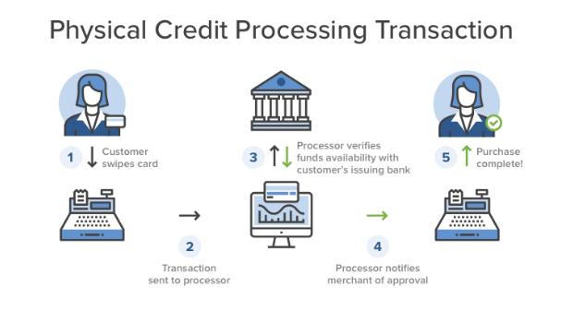
BANKING TRANSACTION
BANK IS THE CENTRAL/ISSUING AUTHORITY OF CREDIT/DEBIT CARDS
Without Central Authority, there is no way for the Merchant to know if the Customer has Money or not.

Slide 4
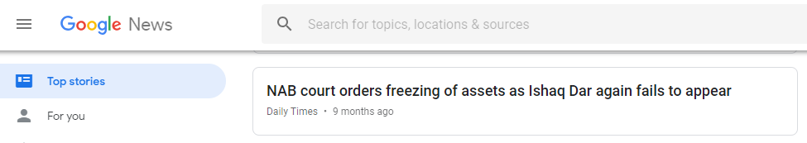
Issue with Central Authority

Slide 5
ARGUMENT AGAINST CENTRAL AUTHORITY
YOUR MONEY IS NOT YOUR OWN
Central Authority decides whether it should grant you access to your Money or not.

Slide 6
PROBLEM: PASSPORT AS Global IDENTITY

Slide 7
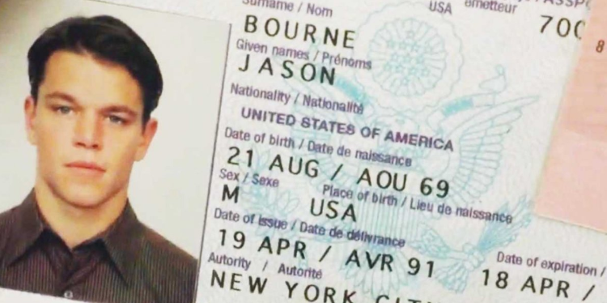
JASON BOURNE’s PASSPORT

Slide 8
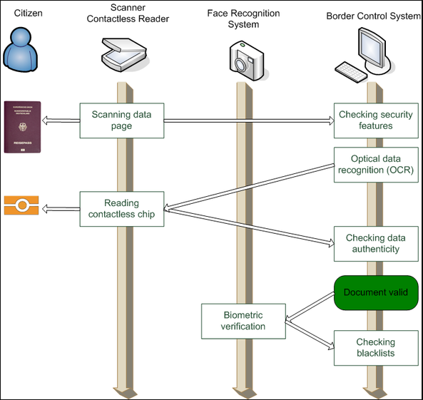
PASSPORT AUTHENTICATION PROCESS
CENTRAL AUTHORITY MUST AUTHENTICATE
Every time a passport is presented at an airport, it is scanned.
During the scan, a request is sent to the Issuing Authority [Foreign Office]
The Foreign Office must authenticate the Passport for the passenger to travel

Slide 9
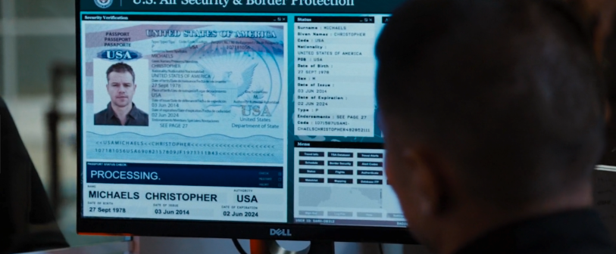
JASON BOURNE’s PASSPORT AUTHENTICATION
CENTRAL AUTHORITY AUTHENTICATING PASSPORT
Jason Bourne’s Passport being Authenticated by US State Department and CIA.

Slide 10
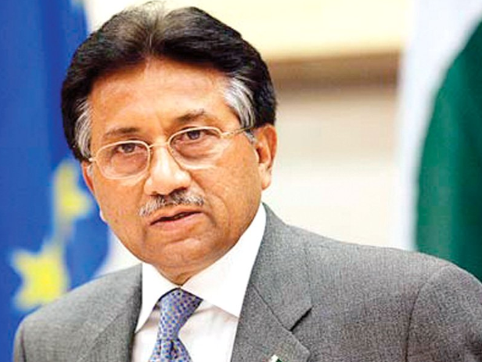
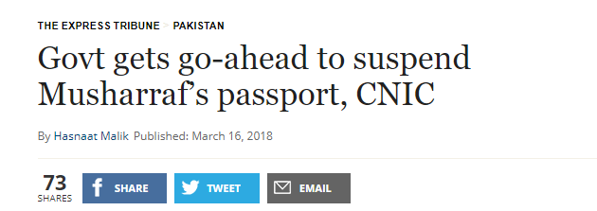
Issue with Central Authority

Slide 11
PASSPORT AS IDENTITY
YOUR IDENTITY IS NOT YOUR OWN
Central Authority decides whether it should grant you access to your Identity or not.

Slide 12
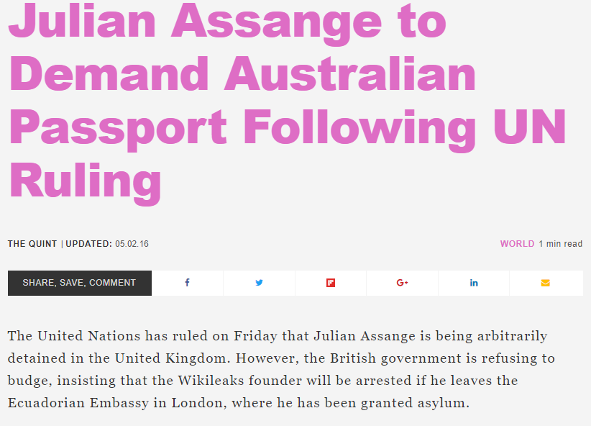
ARGUMENT AGAINST CENTRAL AUTHORITY
GOVERNMENTS CAN EVEN DECIDE NOT TO ISSUE PASSPORTS TO ITS CITIZENS
Thus depriving its citizens with their identity

Slide 13
PROBLEM: HEC DEGREE VERIFICATION SAGA

Slide 14
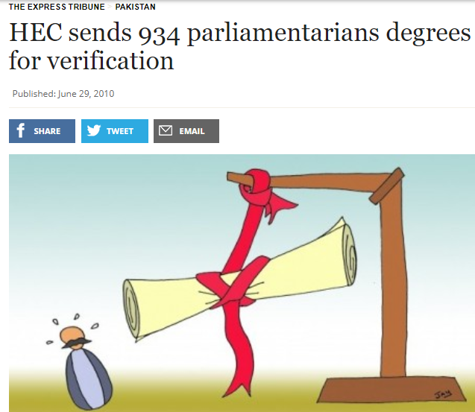
PARLIAMENTARTIAN DEGREEs
THE DEGREE MILL
Musharraf Era Law: Every parliamentarian must have a bachelors degree.
Parliamentarian’s got degrees overnight.

Slide 15
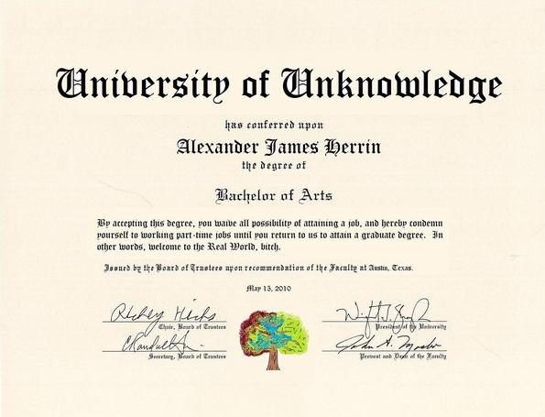
SCENARIO: FAKE DEGREE PRINTED BY PARLIAMENTARIAN
PARLIAMENTARIAN PRINTS FAKE DEGREE HIMSELF
No record exists at the University.
Easier to catch during verification.

Slide 16
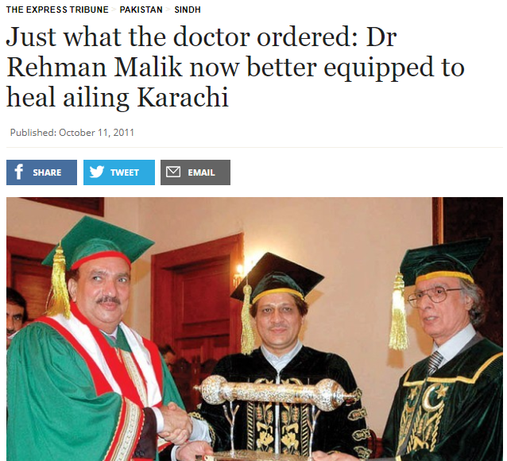
SCENARIO: UNIVERSITY ACTUALLY ISSUES A FAKE DEGREE
UNIVERSITY ACTUALLY ISSUES THE DEGREE
In return for a bribe
As a political favor
Would get verified during the verification process

Slide 17

ARGUMENT AGAINST CENTRAL AUTHORITY
CENTRAL AUTHORITY CAN BE CORRUPTED
Specially true in 3rd World Countries

Slide 18
BLOCKCHAIN: TECHNOLOGY TO VERIFY ASSETS WITHOUT CENTRAL AUTHORITY

Slide 19
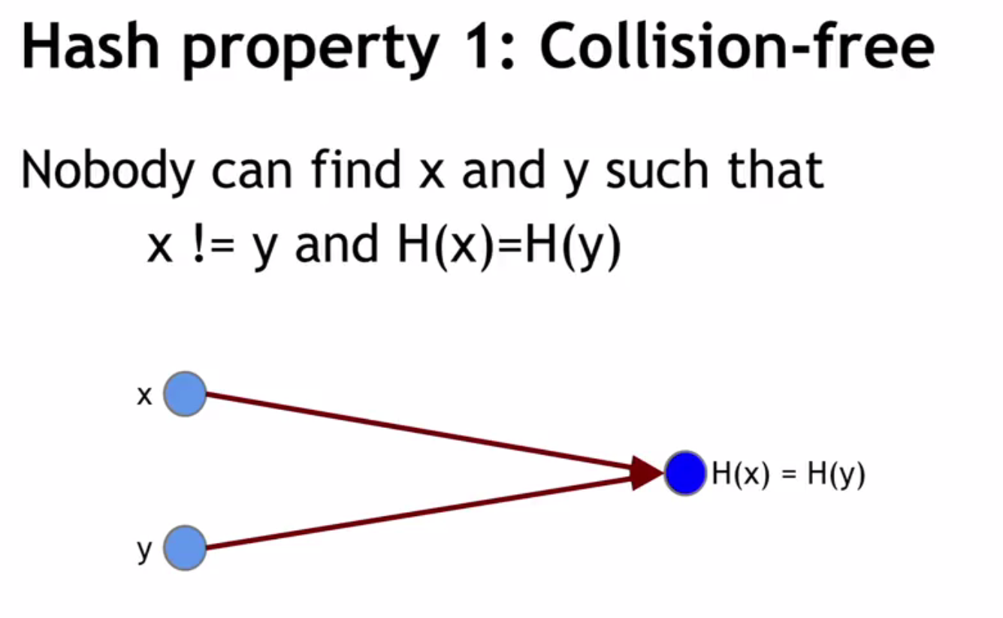
HASH

Slide 20
HASH
BLOCK | HASH
Dr. Bilal Hameed | HxYj10
Engr. Rizwan Ali | BjKL78
Azmat Khan | AgTb38
Dr. Sufian Hameed | MiHc50
PROPERTIES
Dr. Bilal Hameed will always hash to HxYj10
Nothing else will ever hash to HxYj10

Slide 21
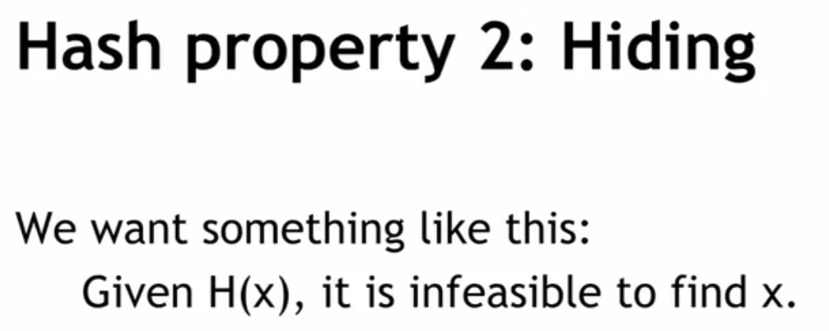
HASH

Slide 22
HASH
BLOCK | HASH
 | HxYj10
 | BjKL78
 | AgTb38
 | MiHc50
PROPERTY
Given Hash HxYj10, you can never retrieve the Text

Slide 23
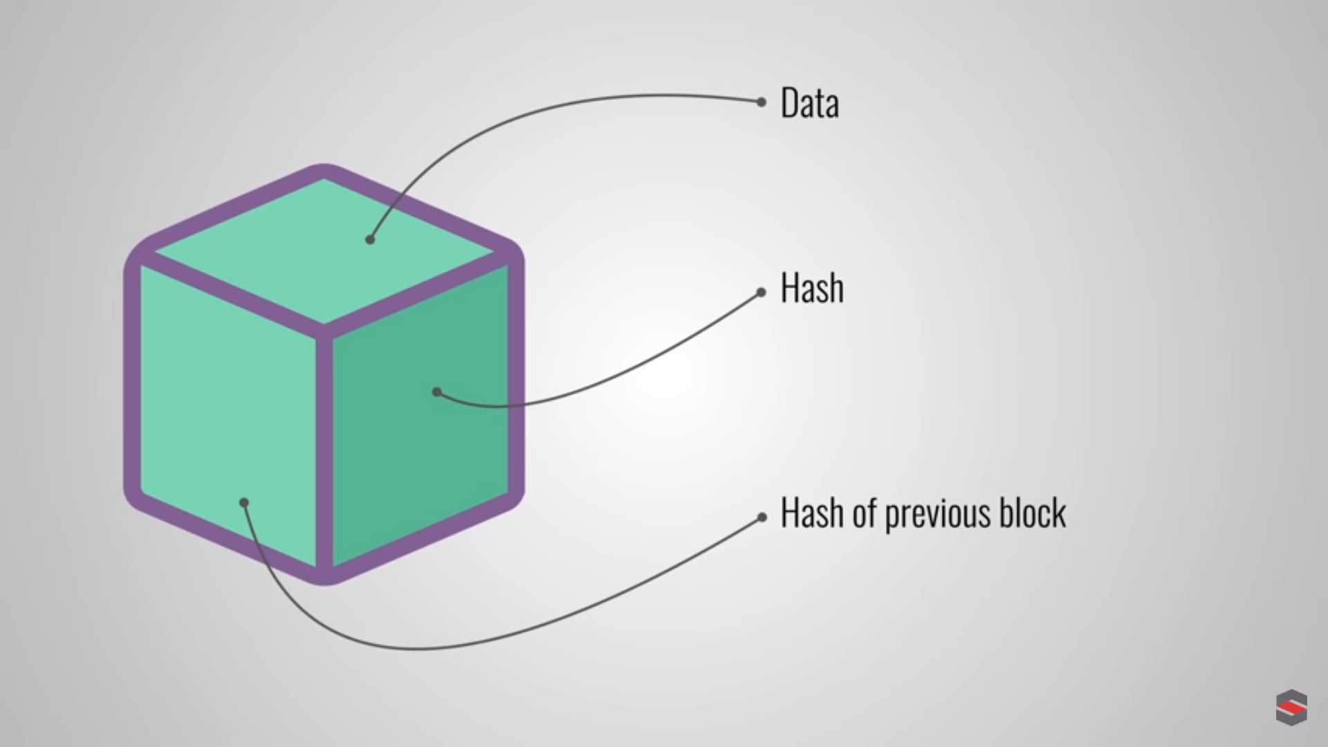
SINGLE BLOCK
SINGLE BLOCK
Data
Hash of Data
Hash of Previous Block

Slide 24
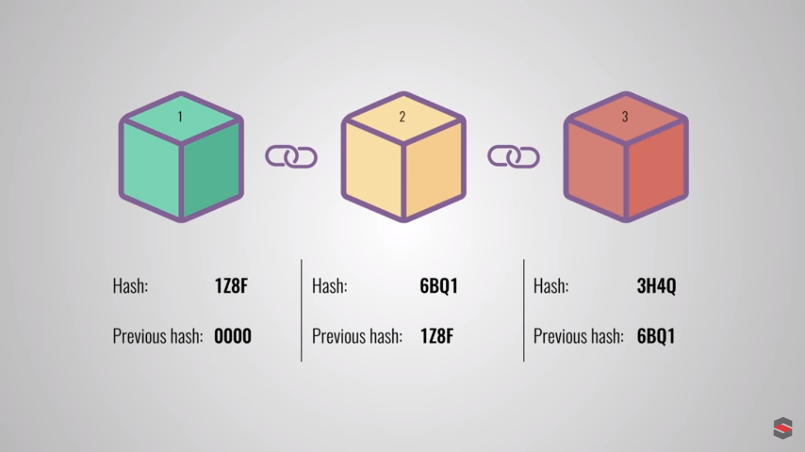
Chain of blocks aka Blockchain
PROPERTY
If any data changes in any of the blocks, hash of Block 3 will change

Slide 25
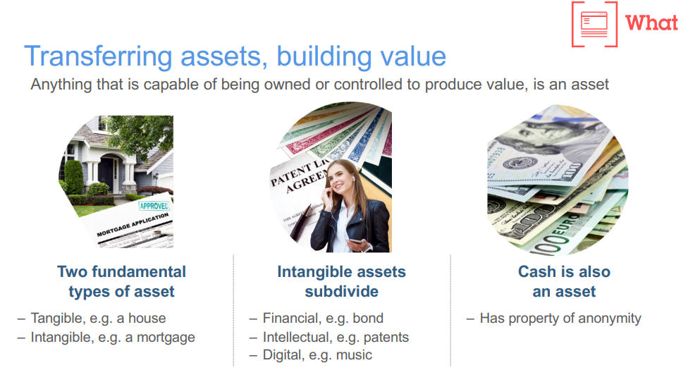
ASSETS
Dr. –Ing. Bilal Hameed – Bahria University Karachi
Copyright – IBM

Slide 26
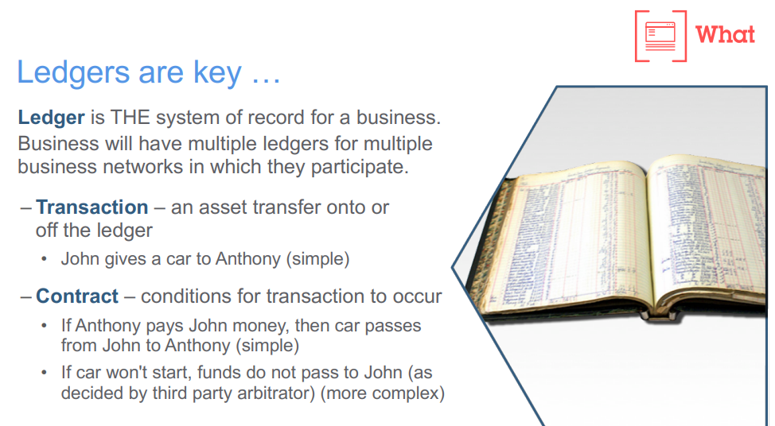
LEDGERS or Transaction Database
Dr. –Ing. Bilal Hameed – Bahria University Karachi
Copyright – IBM

Slide 27
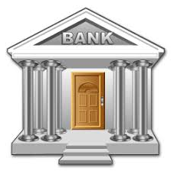


LEDGER/RECORD MAINTENANCE: OLD DAYS
CURRENCY: banks maintain record of assets (debit/credit) of each customer and hence can decide whether to grant access to a customer or not.
PASSPORTS: Foreign Office maintains record of all passports granted and hence can revoke passports at will.
DEGREES: Universities maintain records of all degrees issued

Slide 28
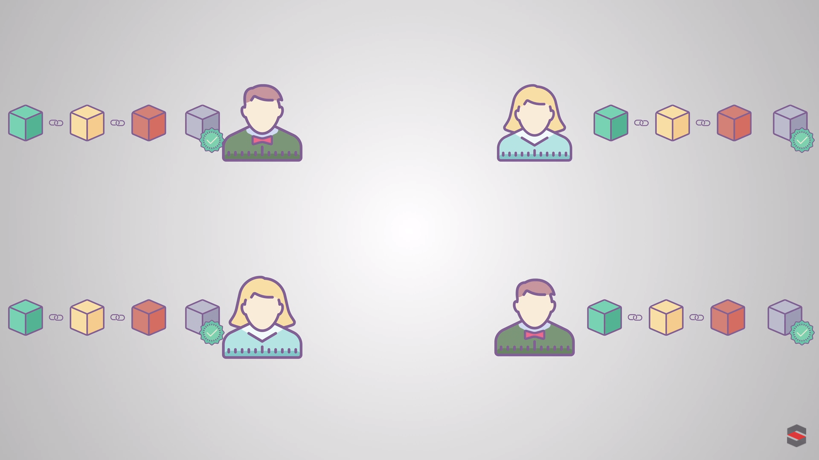
LEDGER/RECORD MAINTENANCE: BLOCKCHAIN ERA
BLOCKCHAIN LEDGER MAINTAINED BY:
Everyone
Distributed Ledger

Slide 29
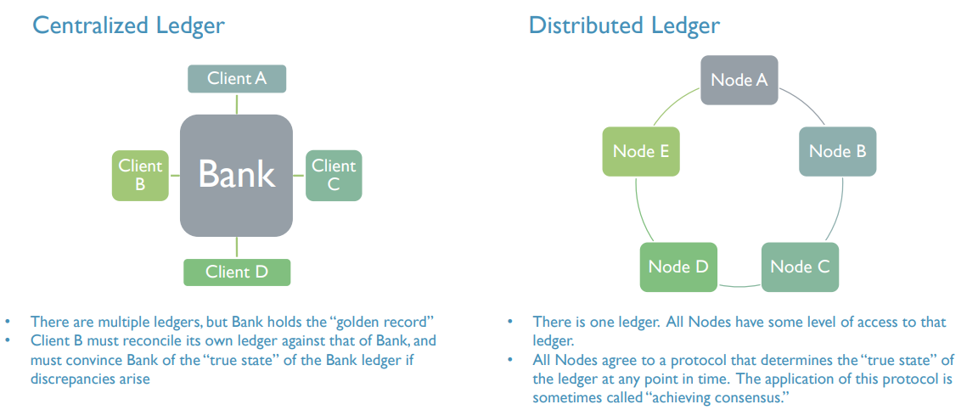
Distributed Ledger
Copyright – Nancy Liao, Yale Law School

Slide 30
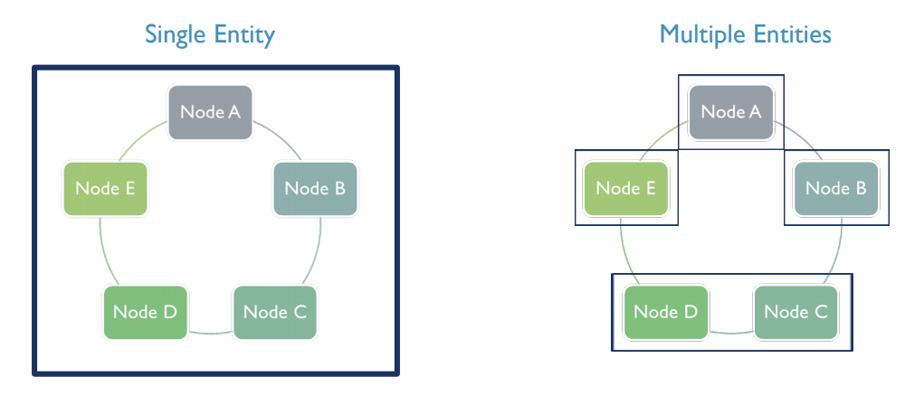
Distributed Ledger
Copyright – Nancy Liao, Yale Law School

Slide 31
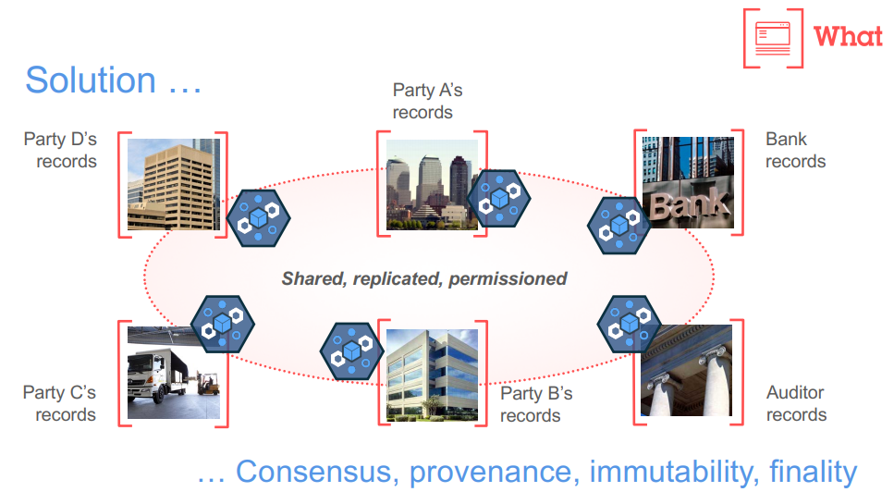
DISTRIBUTED LEDGER
Copyright – IBM

Slide 32
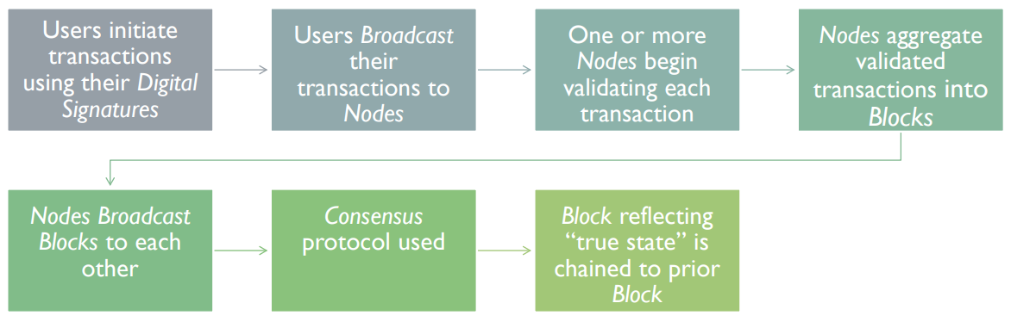
DISTRIBUTED LEDGER TRANSACTOIN
Copyright – Nancy Liao, Yale Law School

Slide 33
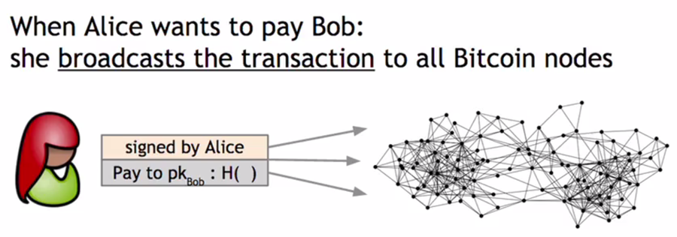
CONSENSUS – 51% RULE
CONSENSUS
Majority Agreement
51% of the network must validate transaction
If validated, new block is added to the longest chain
Validation would mean different things for:
University Degrees
Currency Transactions
Land Titles, etc

Slide 34
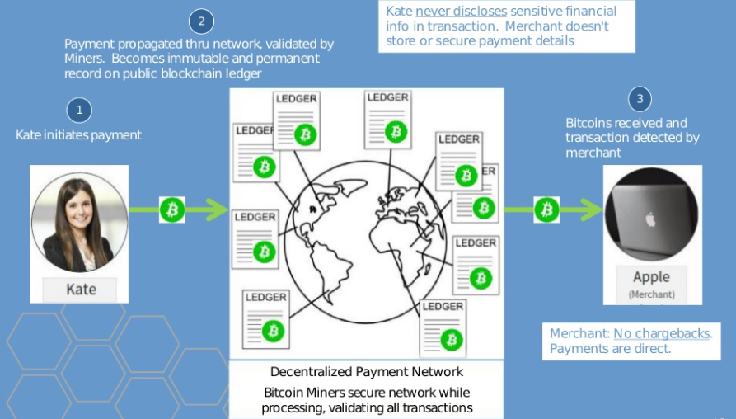
TRANSACTION EXAMPLE - BITCOIN
Copyright – Michael Novak

Slide 35
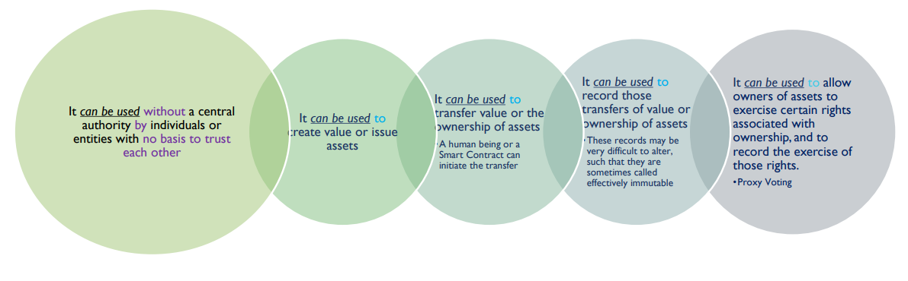
BENEFITS OF DISTRIBUTED LEDGER
Copyright – Nancy Liao, Yale Law School

Slide 36
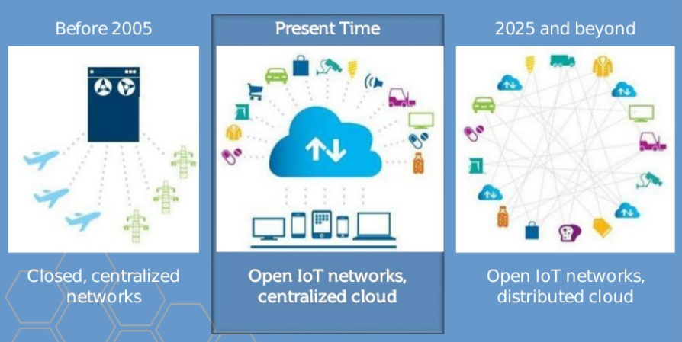
BLOCKCHAIN ERA NETWORKS
Copyright – Michael Novak

Slide 37
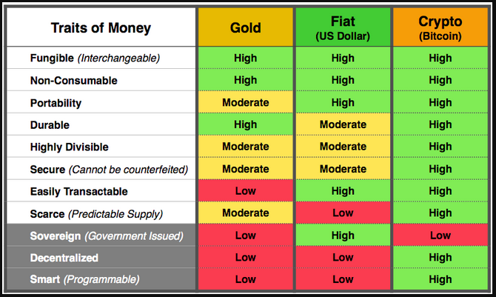
BITCOIN VS MONEY

Slide 38
USE CASE: SMART CONTRACTS

Slide 39
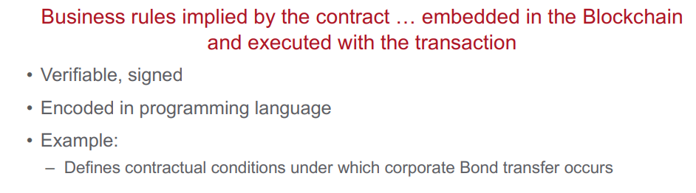
SMART CONTRACT

Slide 40
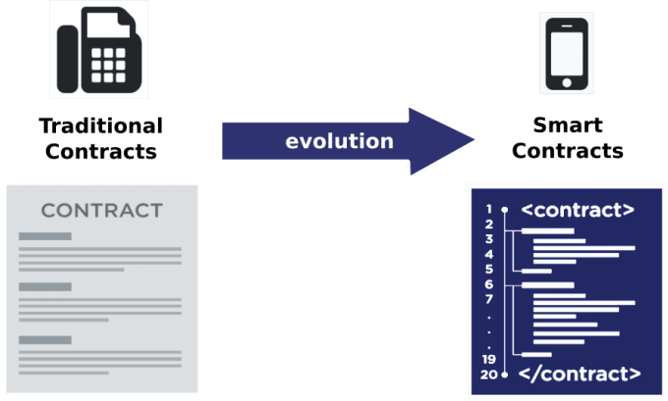
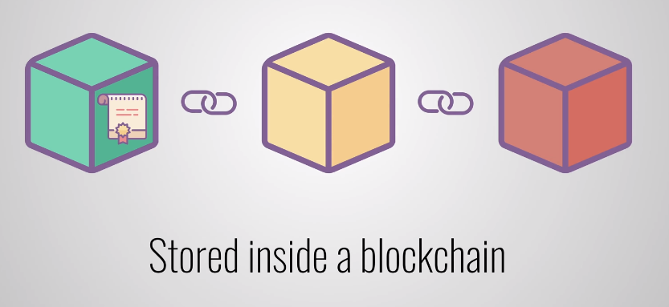
SMART CONTRACT

Slide 41
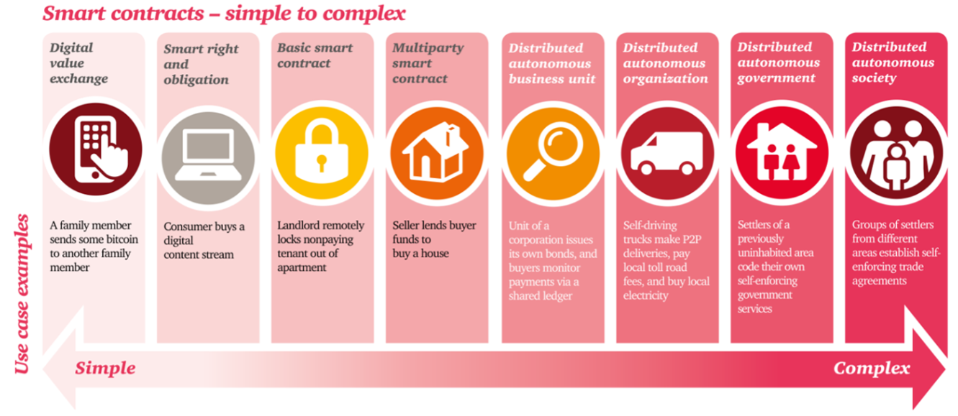
SMART CONTRACTS

Slide 42
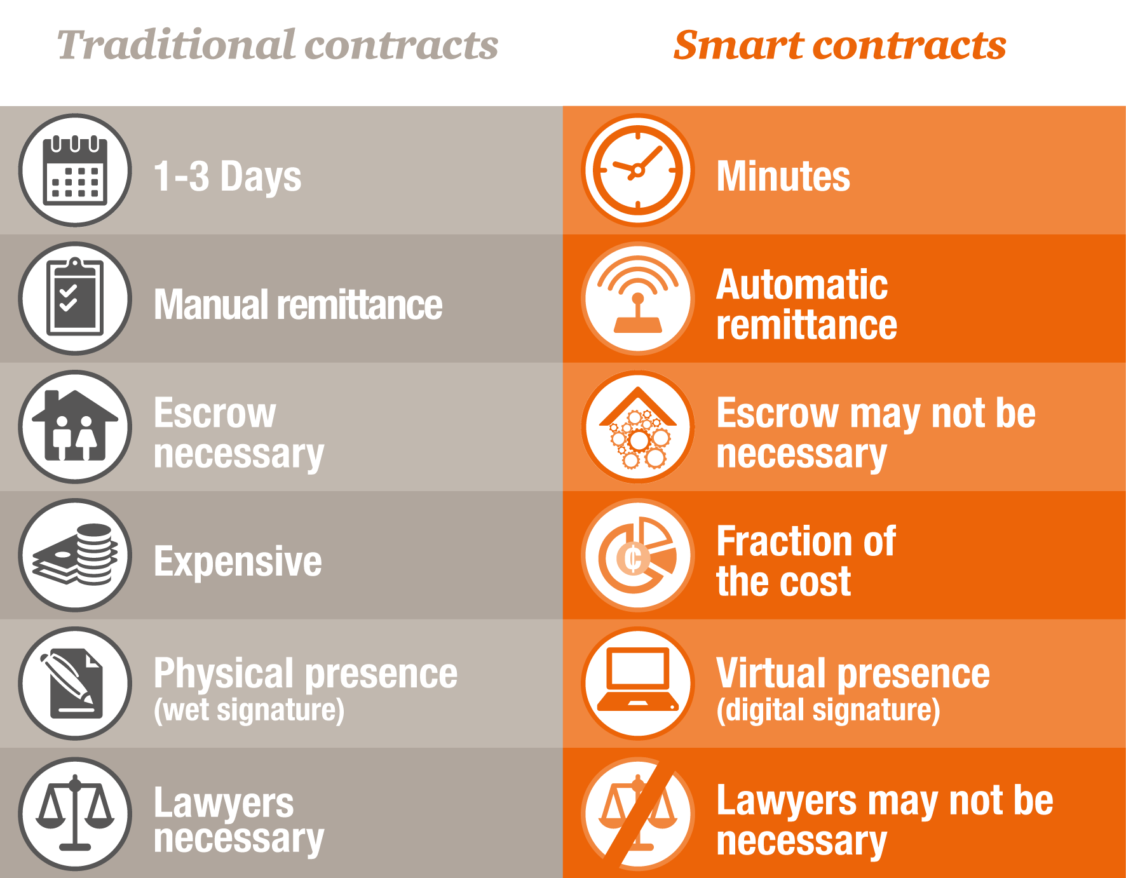
SMART CONTRACTS

Slide 43
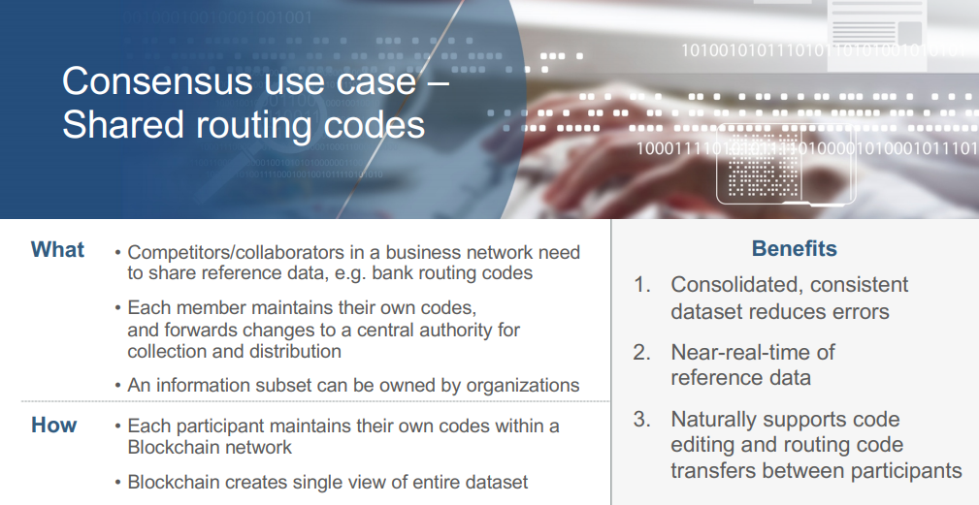
SHARED routing codes
Copyright – IBM

Slide 44
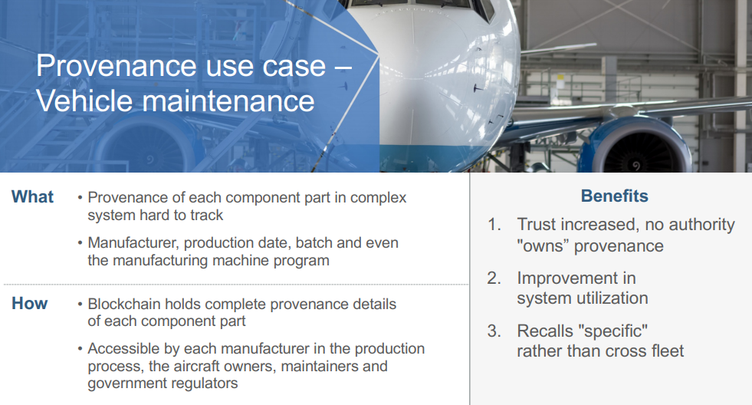
PROVENANCE
Dr. –Ing. Bilal Hameed – Bahria University Karachi
Copyright – IBM

Slide 45
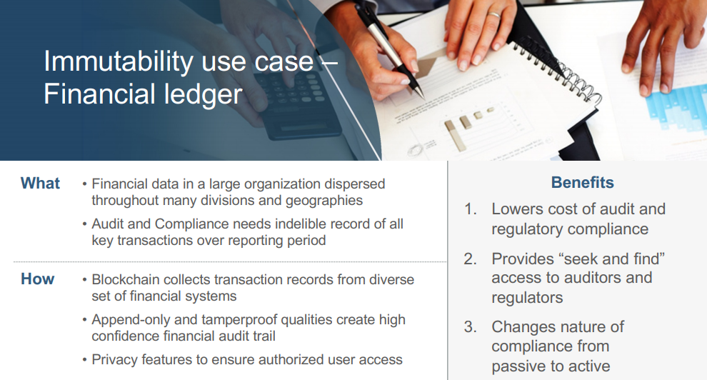
FINANCIAL LEDGER
Dr. –Ing. Bilal Hameed – Bahria University Karachi
Copyright – IBM

Slide 46
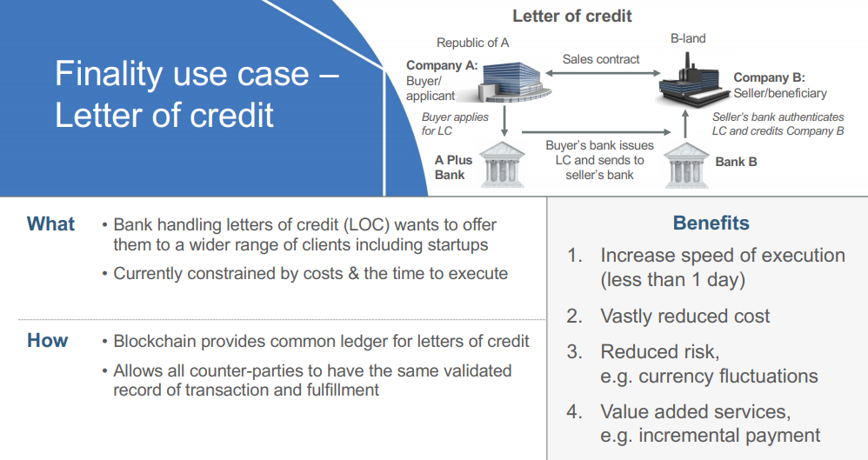
LETTER OF CREDIT
Dr. –Ing. Bilal Hameed – Bahria University Karachi
Copyright – IBM

Slide 47
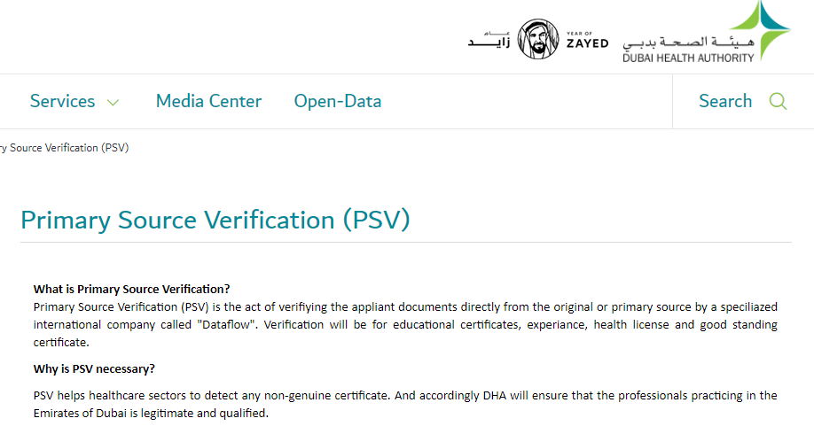
Primary Source Verification - Dubai
PRIMARY SOURCE VERIFICATION
Cost: 1500 AED
Time: 1 Month

Slide 48

SPRINGROLE – LINKEDIN On BLOCKCHAIN
SPRINGROLE
Instantaneous Attestations/Verifications
https://beta.springrole.com/

Slide 49
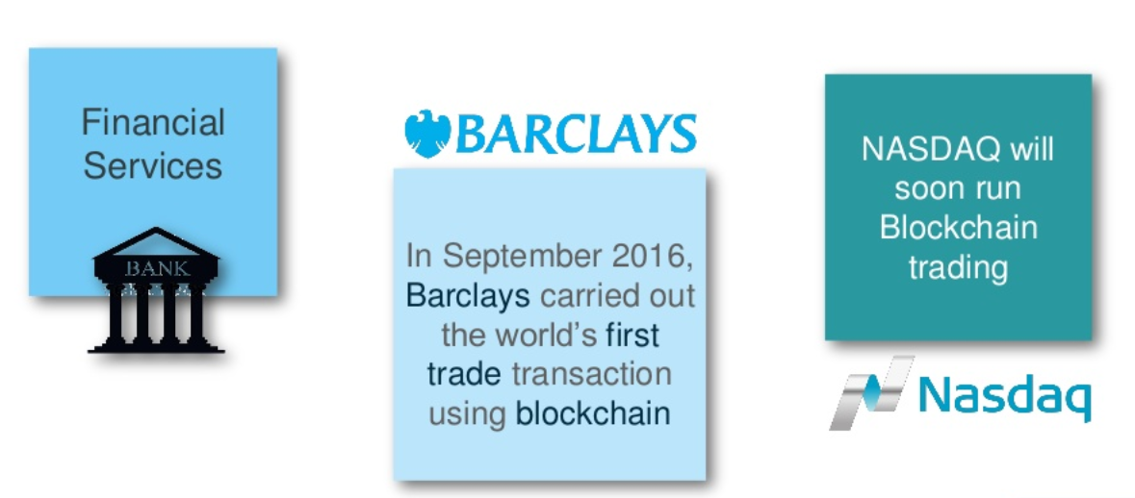
SECURITies SETTLEMENTS
Copyright – Edureka

Slide 50
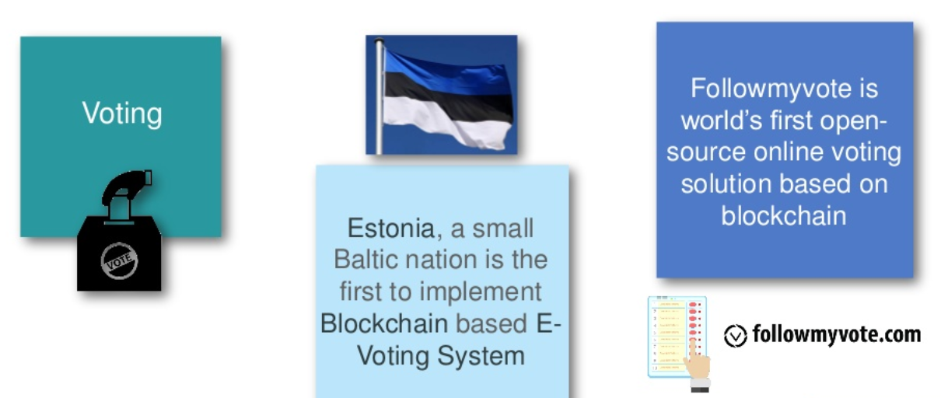
E-VOTING
Copyright – Edureka

Slide 51
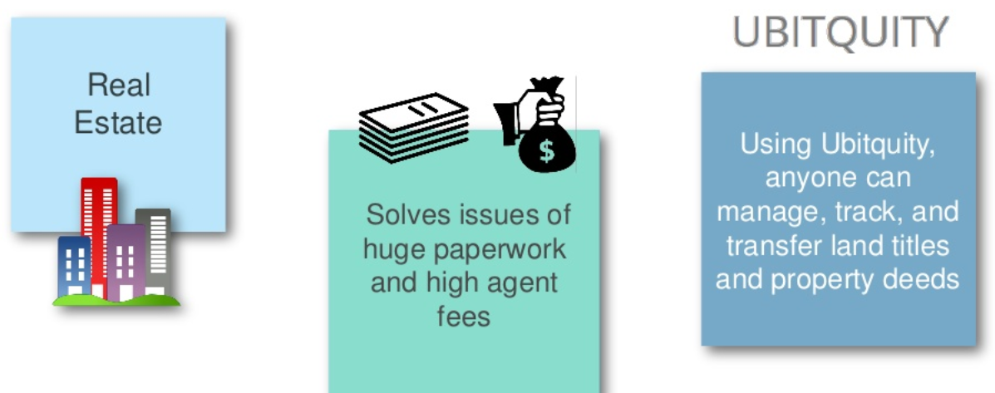
LAND TITLES
PROPERTY TRANSFER TIME – UAE: 30-45 Days
Copyright – Edureka

Slide 52
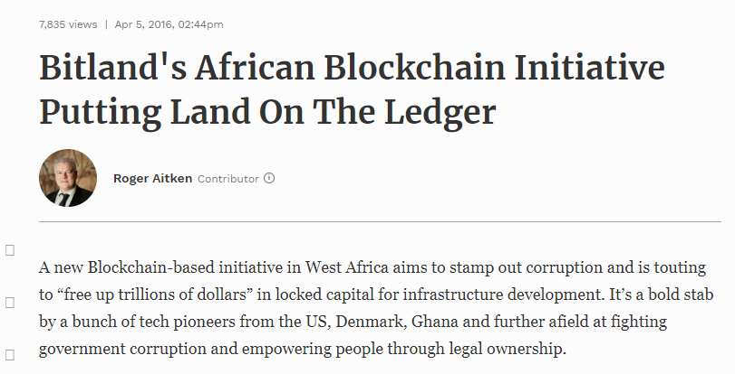
LAND TITLES – BITLAND GHANA
PROPERTY TRANSFER TIME – BLOCKCHAIN: 1-5 Minutes
Source – Forbes

Slide 53
Industries BlockChain will Distrupt

Slide 54
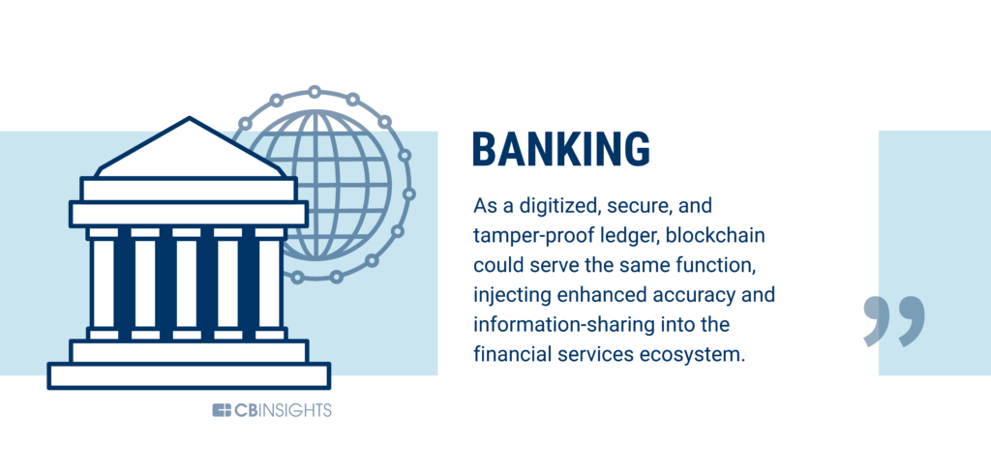
Blockchain Distruption

Slide 55
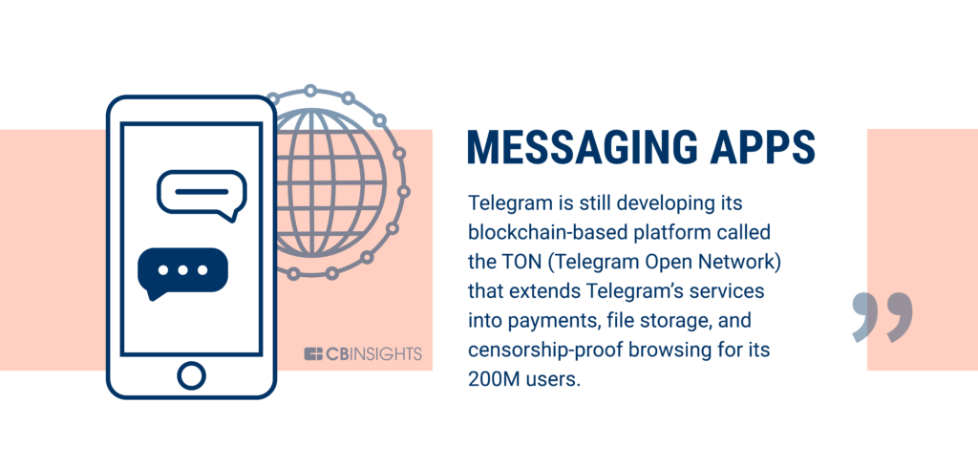
Blockchain Distruption

Slide 56
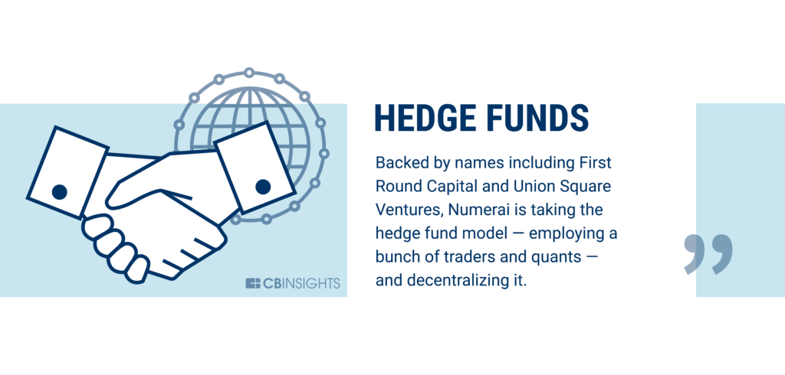
Blockchain Distruption

Slide 57
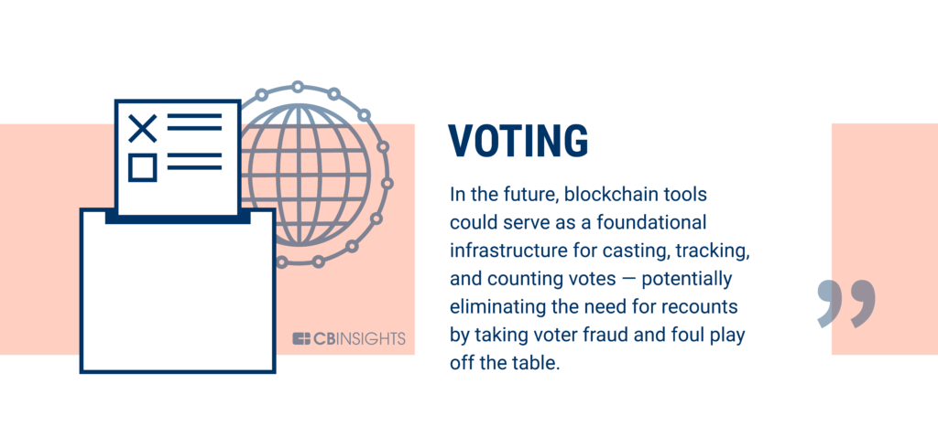
Blockchain Distruption

Slide 58
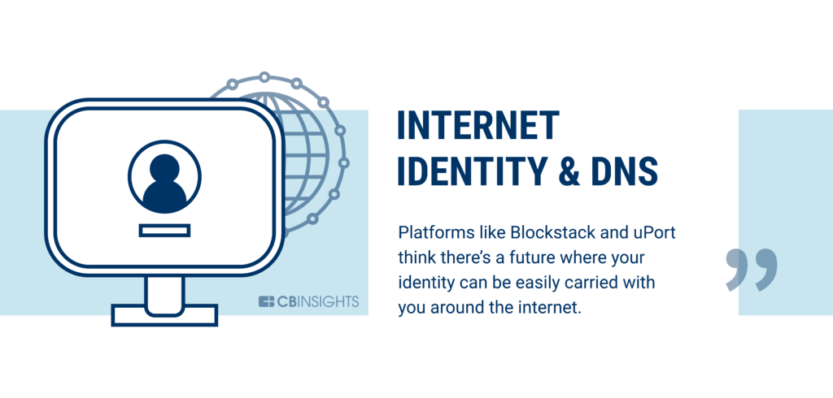
Blockchain Distruption

Slide 59
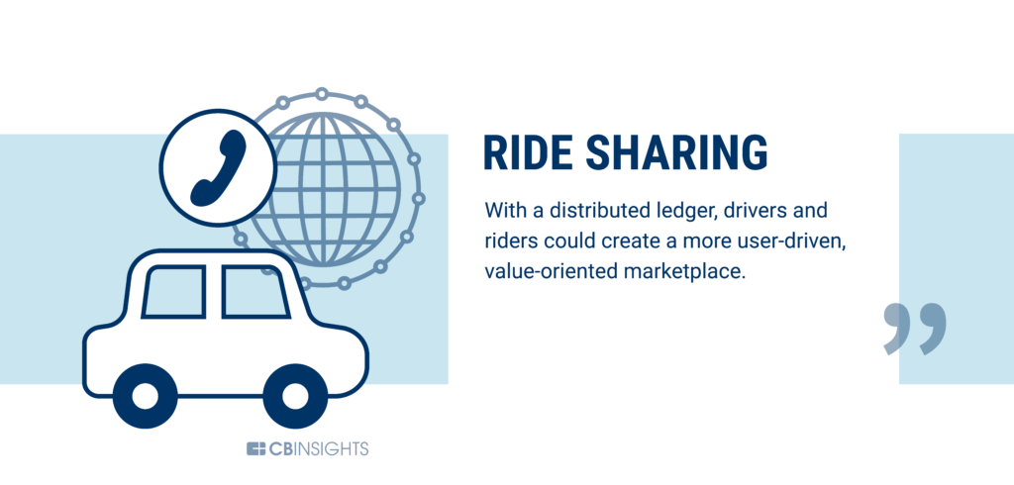
Blockchain Distruption

Slide 60
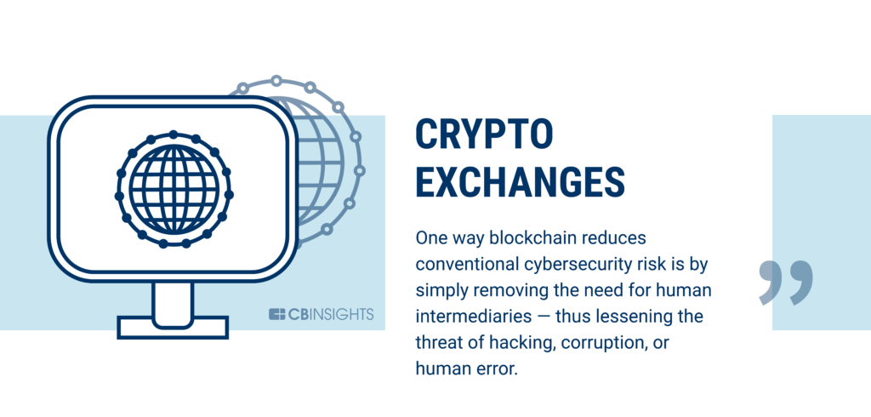
Blockchain Distruption

Slide 61

Blockchain Distruption

Slide 62
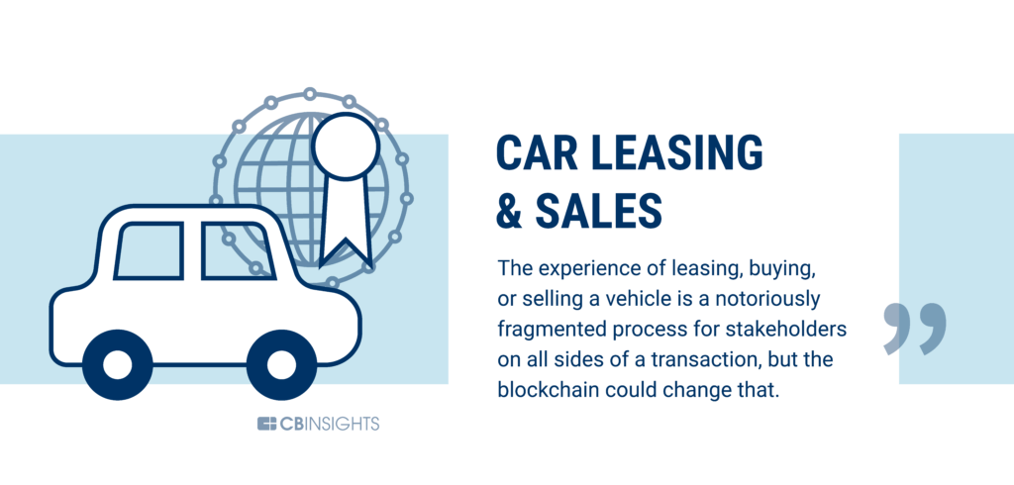
Blockchain Distruption

Slide 63

Blockchain Distruption

Slide 64

Blockchain Distruption

Slide 65

Blockchain Distruption

Slide 66

Blockchain Distruption

Slide 67

Blockchain Distruption

Slide 68

Blockchain Distruption

Slide 69

Blockchain Distruption

Slide 70

Blockchain Distruption

Slide 71

Blockchain Distruption

Slide 72

Blockchain Distruption

Slide 73

Blockchain Distruption

Slide 74

Blockchain Distruption

Slide 75

Blockchain Distruption

Slide 76

Blockchain Distruption

Slide 77

Blockchain Distruption

Slide 78

Blockchain Distruption

Slide 79

Blockchain Distruption

Slide 80

Blockchain Distruption

Slide 81

Blockchain Distruption

Slide 82

Blockchain Distruption

Slide 83

Blockchain Distruption

Slide 84

Blockchain Distruption

Slide 85

Blockchain Distruption

Slide 86

Blockchain Distruption

Slide 87

Blockchain Distruption

Slide 88

Blockchain Distruption

Slide 89

Blockchain Distruption

Slide 90

Blockchain Distruption

Slide 91

Blockchain Distruption

Slide 92

Blockchain Distruption

Slide 93

Blockchain Distruption

Slide 94

END NOTE
Copyright – IBM

Slide 95
BLOCKCHAIN
Problem, Technology and the use cases
Slides prepared by Dr. –Ing. Bilal Hameed – Bahria University Karachi

